Slide 1

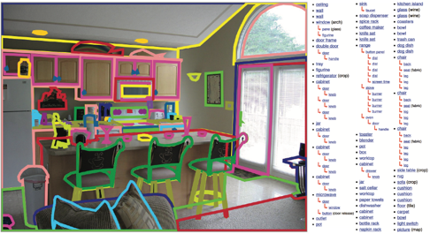


Scene Parsing through ADE20K Dataset
Bolei Zhou, Hang Zhao, Xavier Puig, Sanja Fidler, Adela Barriuso, Antonio Torralba
Introduction of the ADE20K Dataset
Three Benchmarks for Scene Understanding
Scene Parsing Challenge at ECCV’16
22,000 scene images with pixel-wise annotation.
Open-vocabulary (no pre-defined list of objects).
Hierarchy of objects and parts.
Single annotator with >5 year time.
150 object categories with 35 stuff classes (wall, sky, road) and 115 discrete objects
Scene parsing
Instance segmentation
Boundary segmentation
Scene Parsing Networks
Places Challenge 2017 is coming to ICCV’17
Applications
Statistics
Cascade Segmentation Network
a) Automatic image content removal. b)Scene synthesis
Annotation consistency
Segmenting objects and parts jointly
61 randomly chosen images are re-annotated, 82.4% of pixels got the same labels.
Error sources include
Segmentation quality: 5.7% pixels
Object naming: 6.0% pixels
Segmentation quantity: 5.9% pixels
Image
Scene parsing
Part parsing
Acknowledgement: This work was supported by Sam- sung and NSF grant No.1524817 to AT. SF acknowledges the support from NSERC. BZ is supported by Facebook Fellowship.

